Slide 1
Pioneering Literacy in the Digital Wild West Empowering Parents and Educators
Joan Ganz Cooney Center &
New America Foundation
The Campaign for Grade-Level Reading
January 2013
Notes:
1
Earlier this year, we proposed to help the GLR Campaign by taking stock of how, where and if technology could make an impact on reading achievement in young children. This is a joint project of the Joan Ganz Cooney Center and the New America Foundation, and it speaks to an interest in exploring connections between literacy and technology that we have had for a long time.

Slide 2
Pioneering Literacy in the Digital Wild West
Empowering Parents and Educators
By Lisa Guernsey, Michael Levine, Cynthia Chiong and Maggie Severns
http://gradelevelreading.net/resources/technology-for-successful-parenting

Slide 3
Can well-deployed technology help equip low-income parents and teachers with the tools and information they need to promote children’s reading? Also:
Key research questions
Can technology help connect parents to literacy initiatives?
How is technology used by teachers in early education?
What helps bridge informal and formal uses?
3
Notes:
Our main research question is this. Corollary questions included these.

Slide 4
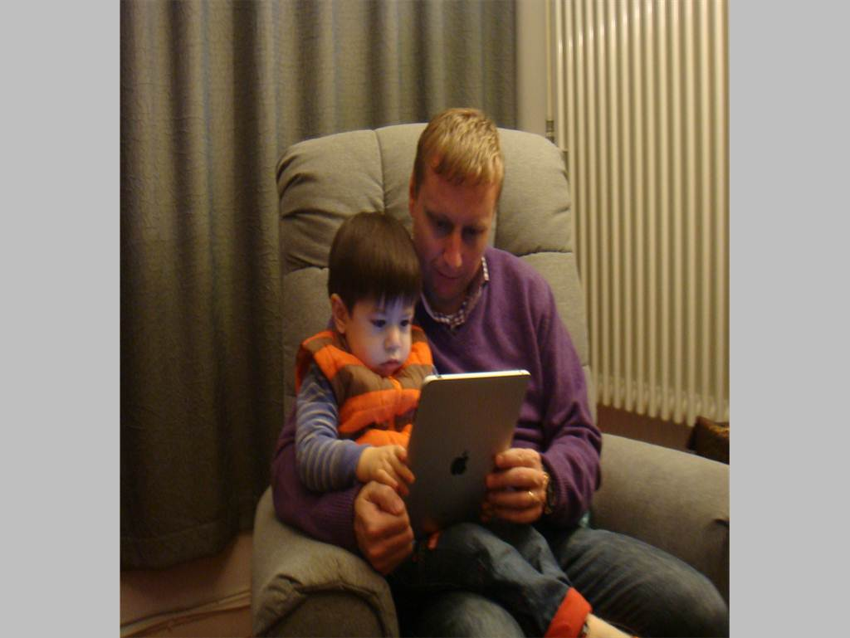
In search of “learning together” moments
Flickr.com/Elaine and Scott van der Chijs courtesy Creative Commons license
Notes:
Let’s talk about that first point for a moment – the idea that depending on content and context, digital media have been shown to spark learning. We recognize that many people – especially those of us who work in early childhood – do not immediately thinking of digital or electronic media as having a positive impact on learning. Instead the image in our heads is a nefarious television with children watching hour after hour, substituting for free play or hands-on activities. But digital media today can be something quite different. For example, in this picture, it looks a lot like a book, with father and son learning together.

Slide 5
4 Guiding Principles
Parents are crucial
To ignore technology is to allow gaps to widen
Skills + knowledge:
Reading requires both
Technology by itself
is not the answer
5
Notes:
5

Slide 6
Neuman & Celano studied two libraries in Philadelphia serving two different socio-economic classes.
Witnessing disparities in how adults interact with children using technology
Finding: Vast differences in how adults interacted with children using computers and digital games, as well as books.
6
Notes:
Almost 1/3 of households still don’t have access to broadband. (ESA & NTIA, 2011), but there is a dearth of information on how low-income families gain access to technology, what kinds of technology and digital media they are more prone to use, what resources are most meaningful to them, and how families learn together (or not) via the media. A seminal study by Susan Neuman and Donna Celano, described in their new book, Giving Our Children a Fighting Chance, showed differences in the quality of interactions that parents and children engaged in while playing digital games or using ‘educational’ software in two libraries in Philadelphia.
6

Slide 7
A swelling marketplace
Over 80% of top selling paid apps in the Education Category target children; of those, 72% target preschool aged children (JGCC, 2012).
Source: 148apps.biz; About.com
7
Notes:
So that gives you a sense of the teeming technology scene for young children and their parents. Let’s turn for a moment to the marketplace, especially the app marketplace. It’s booming. Look at this growth in apps from mid 2008, when the iTunes store opened, to today. This goes to June 2012, and the more recent numbers from 148apps.biz show that there are now about 730,000 active apps available to buy or install. Games and education are the top two categories in the iTunes store. In the education category, children are a big target. Preschool children especially.
7

Slide 8
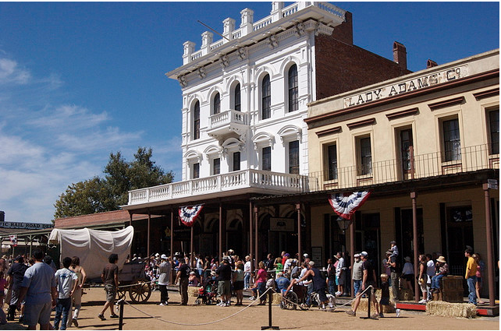
Feeling a little like the Wild West
TarynMarie on Flickr via Creative Commons license
Thomas Hawk and Thom Ross on Flickr via Creative Commons license
Notes:
What are those apps like? Who makes them? What qualifications do they have? Whose interest is at heart?
Who’s to say. It feels the Wild West.
8

Slide 9
Our scan of the landscape
A two-pronged approach
Products
Apps
E-books
Games
Websites
Programs
Supporting parents
Assisting teachers
9
Notes:
We Conducted a Scan of the Landscape: What Technologies are Available? We took a two-pronged approach: seeking out examples of products and interventions/programs.
Professional development models
Comprehensive curriculum packages
Projects funded through federal or state grants
9

Slide 10
Product Scan
April 2012
Notes:
10
So let’s get into what we have found.

Slide 11
Key finding: most of the popular apps target very basic literacy skills
11
Notes:
Note that 6 out of 8 of the android apps that were vocabulary were just flashcards.
Also, no apps targeted “print concepts” but it looked weird to have a blank in the front and it doesn’t fit.
11

Slide 12
Program Scan April 2012 – November 2012
12
Notes:
12

Slide 13
Interviews and research
Notes:
Our teams at New America and the Cooney Center have been interviewing literacy program leaders, librarians, teachers and researchers around the country to glean how they use technology and if they have words of wisdom for how it should be employed to help young children learn to read. Here are logos for many but not all of the interviewees we’ve talked to so far.

Slide 14
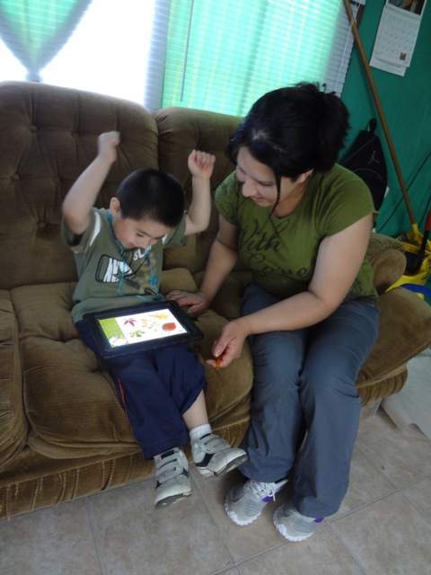
Comienza en Casa
Migrant family literacy in Maine
iPads + offline ‘play-based’ language activities
Ele, by the Fred Rogers Center
Early learning environment for home-based caregivers, including parents
“Library and playroom”
Create “playlists” of activities
The Baby Elmo Program
Modeling positive parenting via Sesame Beginnings videos
For incarcerated fathers
Findings: Pioneers in using tech to support parents
Bonnie Blagojevic for Comienza en Casa in Maine
14
Notes:
Through these interviews, we’ve heard about interventions and programs that are using digital media or, in some cases, more traditional electronic media, such as DVDs. In many cases, the programs are aimed at helping teachers and caregivers of young children. Here are three.
14

Slide 15
Wonderopolis
National Center for Family Literacy
“Wonder of the Day” for language/cognitive development
Storytimes Online
Picture-book-of-the-day via free e-subscription & literacy activities daily on public library websites
Idaho (recent winner of IMLS grant), Virginia, South Carolina
Supporting parents, continued
15
Notes:
2007 to 2011
FARMS – 34.8 to 17.5
Non-FARMS – 29.8 to 9.8
15

Slide 16
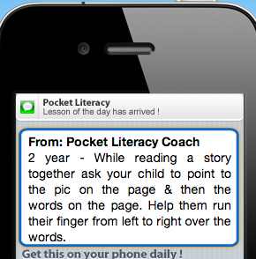
Pocket Literacy via Ounce of Prevention Fund
Sends daily texts to parents’ mobile phones with ideas for literacy activities
Head Start parents will evaluate the service in 2013
Mind in the Making Learning Communities
Parents, educators and health professionals gather to watch video clips from baby experiments and discuss Ellen Galinsky’s Mind in the Making
35 organizations in 22 states
Supporting parents, continued
16
Notes:
16

Slide 17
Children’s Literacy Initiative’s Compass
Free video library of strategies for teachers (how to engage children in books, dialogic reading techniques). Dept. of Ed funded.
Success for All embedded video
Augmenting reading lessons with video clips and computer-assisted tutoring.
Targeted Reading Intervention
Webcam coaching of reading teachers. University of North Carolina.
Findings: Pioneers in using tech to assist teachers
17
Notes:
Through these interviews, we’ve heard about interventions and programs that are using digital media or, in some cases, more traditional electronic media, such as DVDs. In many cases, the programs are aimed at helping teachers and caregivers of young children. Here are three.
17

Slide 18
Assisting teachers, continued
Innovations for Learning
Computer-based reading programs assist teachers and enable volunteer tutors who call students in the classroom via a Skype-like system as children read online books
iRead
Students use iPods to record themselves reading books; teachers listen to audio files and personalize instruction according to what they hear.
Ready to Learn “transmedia” products
Creating and evaluating suites of learning products for parents and teachers across various platforms, including TV, Internet, and tablets.
18
Notes:
Through these interviews, we’ve heard about interventions and programs that are using digital media or, in some cases, more traditional electronic media, such as DVDs. In many cases, the programs are aimed at helping teachers and caregivers of young children. Here are three.
18

Slide 19
Future mapping: Four approaches to consider
Promoting personal connection
Reinforcing basic skills
Building background knowledge
Improving the workforce
Social networking
App games that test phonics knowledge
Video field trips
Professional dev hubs / online courses
Texting via mobile device
Flashcards for sight words
Children’s literature available as e-books
Better, on-demand access to curricular materials
Notes:
In our interviews and analyses of the marketplace, we’re seeing some trends. Here are four approaches to using technology that are either apparent or mentioned as being desirable.

Slide 20
Conduct community audits. Assess disparities in access and capacity to deploy technology for literacy outreach.
Create public engagement initiatives on the need for critical thinking about media.
Create a place in every community where parents and educators can experiment together with online and offline media as a springboard for children’s literacy.
Support sound research on how both technology content and contexts are affecting reading development.
Create partnerships for innovation. Stimulate collaboration among tech industry, educators, parents and community institutions such as schools, libraries and universities.
5 Recommendations:
From the Wild West to Pioneering “Literate Communities”
For the full report, see:
http://gradelevelreading.net/resources/technology-for-successful-parenting
20
Notes:
20

Slide 21
Contact us
joanganzcooneycenter.org
Facebook.com/cooneycenter
twitter.com/cooneycenter
earlyed.newamerica.net
twitter.com/edpolicyatNAF
guernsey@newamerica.net
Notes:
21

